Slide 1
Summary of New 2019 Abridged ART Guidelines
June 2019

Slide 2
Outline
Goals of ART
Drug Related Changes
DTG in first line regimens
Monitoring on ART
VL Monitoring and response
Switching regimens
Switching stable clients to DTG

Slide 3
Goals of ART
Achieve and maintain
Viral Suppression
Decrease opportunistic infections and other HIV-related conditions
Minimise the development of treatment resistance
Decrease the morbidity and mortality from HIV/AIDS
Improve quality of life
Minimise Rx side-effects and toxicity
Notes:
Let us recall why we put clients on ART. VL suppression is key to achieve all the goals of ART. Potent, well tolerated regimens are of critical importance to achieving and maintain VL suppression.

Slide 4
Dolutegravir and it’s impact on 1st Line Regimens

Slide 5

Dolutegravir
Why are all the excitement about DTG?
TDF, 3TC, and DTG (TLD) is a potent ART regimen
Superior efficacy and faster rate of viral suppression
Well tolerated
High genetic barrier to resistance
No drug interactions with contraception
Notes:
Dolutegravir (DTG) has many benefits, as listed above, particularly the rapid rate of viral suppression and high genetic barrier to resistance, which means that resistance develops more slowly.

Slide 6







DTG: Dosages and Formulations
Class of ARV: Integrase Inhibitor (InSTI)
Standard Dose: DTG 50mg daily
Who may get DTG?
Children, adolescents and adults > 20 kg:
Formulations:
DTG 50 mg tablet
children and adolescents 20 - 35 kg
Fixed-dose combination: TLD
Tenofovir (TDF) 300 mg + lamivudine (3TC) 300 mg + DTG 50 mg (TLD).
TLD can be prescribed for patients > 35 kg and > 10 years of age (restricted by TDF).
DTG dose with concomitant TB Treatment:
Double DTG dose to 50 mg 12-hourly.
If on TLD FDC, add DTG 50 mg 12 hours after TLD dose
> 20 kg
Notes:
Note the difference between weight bands
DTG can be used for > 20 kg
TLD only from 35 kg, due to restrictions on TDF, not DTG

Slide 7

DTG and Neural Tube Defects
A safety signal has been raised about the possible risk for NTDs in women using DTG around the time of conception (0.69% vs 0.1%).
No adverse pregnancy outcomes if DTG is started after the neural tube has closed
Therefore, be cautious in:
women wanting to conceive,
women not on reliable contraception, and
pregnant women in the 1st trimester.
It is recommended that WOCP that do not currently wish to become pregnant, use contraception if using DTG.
If her fertility intentions change, and she desires a pregnancy, she should switch back to EFV
Respect women’s autonomy in decision-making about their health and enable women to make informed choices
Understand her fertility intentions
Risk and benefits of DTG vs EFV
Provide contraception options
Integration of ART and Family Planning services essential!
Notes:
In an unplanned preliminary analysis of an ongoing study in Botswana, 0.69% (4/596) of babies born to mothers already taking DTG at the time of conception had a neural tube defect (NTD). This compares to 0.1% (14/11173) of babies exposed to other maternal ART. An analysis from the same and other studies in women who started treatment after falling pregnant found no significant differences between DTG and EFV-based regimens on any adverse birth outcomes.

Slide 8
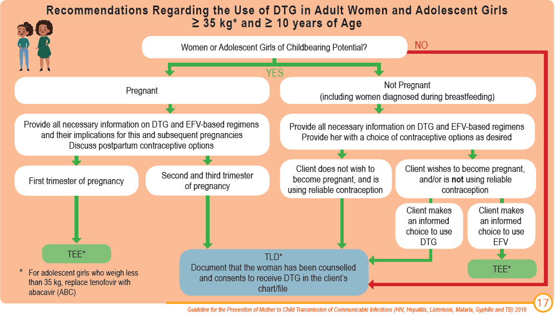
1st Line Regimens for Women and Adolescent Girls
Notes:
WOCP - DTG is not recommended for:
Women wanting to conceive
Women not on reliable contraception
Women in the first trimester of pregnancy
WOCP - DTG is recommended for:
All non-pregnant and breastfeeding women using reliable contraception
Pregnant women in the second and third trimester
Women who are not on contraception, but who have been counseled on the risks and benefits, and who have made an informed choice to use DTG
Ultimately, we have to respect the woman's ability to choose having been given all the information required to make an informed choice.
If she opts to use DTG without contraception against recommendations, her choice must be documented in the clinical file.

Slide 9


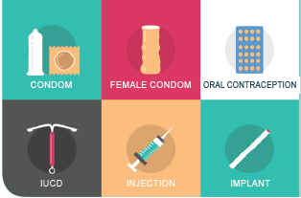
Enabling a Client to Make an Informed Choice
The clinician should enable a client to make an informed choice by doing the following:
1
2
3
Understand her current pregnancy status and fertility intentions:
Is she pregnant?
Does she desire a pregnancy: now? or in the future?
or not at all?
Explain the risks and benefits of DTG vs EFV (see next slide)
Remember that EFV remains a safe and effective alternative
Discuss and provide a choice of contraceptive options as desired
Remember that dual methods are recommended
Notes:
Contraception is recommended for any women taking or starting DTG. Provide a choice of contraceptive options as desired (including condoms, oral contraceptives, implants, injectables, and intra-uterine contraceptive devices (IUCDs). Dual methods are recommended, and consist of a hormonal method or IUCD to prevent pregnancy, and a barrier method (male/female condoms) to prevent STIs and HIV transmission.

Slide 10
Risks and Benefits of DTG vs EFV
Benefits of using DTG | Risks of using DTG
Provides rapid viral suppression | DTG may increase the risk of neural tube defects (NTDs) if used in the first four weeks after conception
High genetic barrier to resistance
No interaction with hormonal contraceptives | Drug interactions with rifampicin, metformin, anticonvulsants, and polyvalent cations (Ca, Fe, Mg)
Side effects are mild and uncommon
Benefits of using EFV | Risks of using EFV
Safe in pregnancy | Low genetic barrier to resistance
No significant interaction with TB treatment | Drug interactions with contraceptives
 | Neuropsychiatric side effects
Should she choose DTG despite recommendations, document her choice in writing in clinical notes

Slide 11
Drug Interactions with DTG
Interacting Drug | Effect of Co-Administration | Recommendation
Rifampicin | Dolutegravir | Double DTG dose to 50mg 12-hourly. If on TLD FDC, add DTG 50mg 12 hours after TLD dose
Anticonvulsants: Carbamazepine Phenobarbital Phenytoin Valproate | Dolutegravir | Avoid co-administration if possible (lamotrigine, levetiracetam, and topiramate do not interact with DTG, and can be used). Double DTG dose to 50mg 12-hourly for carbamazepine if alternative anticonvulsant cannot be used
Metformin | Metformin | Maximum metformin dose 500mg 12-hourly
Polyvalent cations – significant interactions → see next slide (Mg2+, Fe2+, Ca2+, Al3+, Zn2+) e.g. antacids, sucralfate, multivitamin and nutritional supplements
Notes:
There are several medications that have significant drug interactions with TLD.
Rifampin: TLD should be continued once daily, but an additional dose of DTG 50mg should be given 12 hours apart. Another important point to note is that Rifampin may potentially interact with some hormonal contraceptives. Therefore, if a woman is taking ARVs and using hormonal contraception, she should be advised about the potential interaction during TB treatment.
Antacids: use two hours before or six hours after TLD dose
Metformin: a lower dose of metformin may be needed with closer monitoring of blood glucose
Patients may be taking several drugs, so it is always important to find out what else they are taking and determine if there are any drug interactions. There is a good resource online that can be downloaded as an app: https://www.hiv-druginteractions.org/checker. This table and the website can also be found in your participant manual, so you will have it as a reference.

Slide 12



Drug interactions between DTG and the polyvalent cations (calcium/ iron supplements and antacids)
+
without food
=
Decreased
DTG levels
DTG
Ca²⁺
or Fe²⁺
=
No effect on
DTG levels
+
+
DTG
Ca²⁺
or Fe²⁺
Food
However, calcium (Ca²⁺) and iron (Fe²⁺) must be taken 4 hours apart
Antacids
=
Decreased DTG levels
take a minimum of 2 hours before or 6 hours after DTG
+
Regardless of food intake
DTG
Mg²⁺
or Al³⁺
Notes:
Pregnant women are routinely asked to take calcium bd to prevent pre-eclampsia, and ferrous sulphate daily to prevent anaemia in pregnancy. But both of these can potentially have important drug interaction with DTG and with each other. Calcium supplements decrease DTG concentrations if taken together on an empty stomach. To prevent this, DTG and calcium supplements can be taken at the same time if taken with food.
Iron supplements decrease DTG concentrations if taken together on an empty stomach. To prevent this, DTG and iron supplements can be taken at the same time if taken with food. However, calcium and iron supplements must be taken at least 4 hours apart.
Magnesium/aluminium containing antacids decrease DTG concentrations regardless of food intake and should be taken a minimum of 2 hours before or 6 hours after DTG.

Slide 13


Suggested Dosing Schedule
DTG (TLD) can be taken in the morning or evening with calcium and with food
If insomnia is experienced, dose in the morning
Option 1
Option 2
DTG + Calcium 500 mg + food in the morning
Ferrous sulphate 200mg at lunch with food (better tolerated)
Calcium 500mg in the evening
Calcium 500 mg + food in the morning
Ferrous sulphate 200mg at lunch with food (better tolerated)
DTG + Calcium 500mg with food in the evening

Slide 14

Benign Increases in Creatinine Levels
(due to decreased tubular secretion)
Serum creatinine levels increase early in treatment (by less than 15%), and remain stable throughout therapy.
This is not an indication to stop DTG.
A creatinine level that keeps on
rising, is however a cause for concern and could indicate
TDF toxicity or other underlying pathology.
Notes:
DTG is known to decrease tubular secretion of creatinine without affecting glomerular filtration.

Slide 15
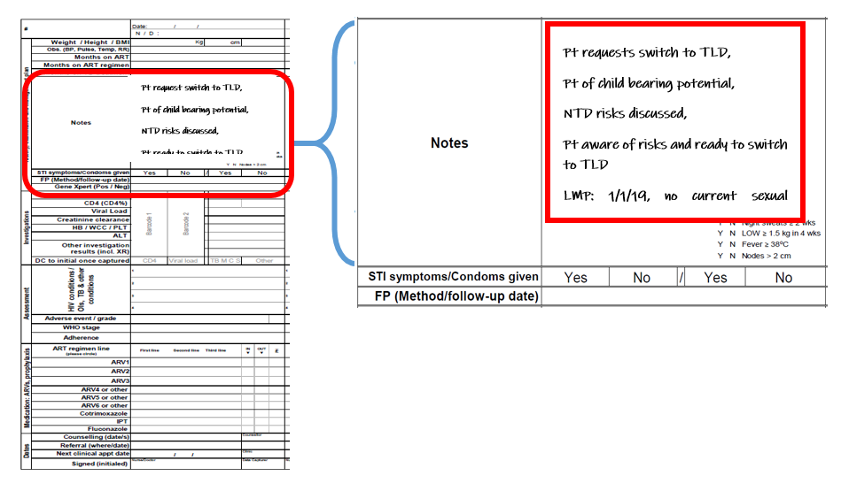
Visit Summary for Women of Childbearing Age
Notes:
Slide: Visit Summary for Women of Childbearing Age
Say:
Earlier it was mentioned that documentation is needed regarding counseling and the informed decisions made by women of childbearing age should be documented. This can also be done using the current stationary
In the “Notes” section of the visit summary, the patient request to initiate or switch to TLD, the current pregnancy and contraception status, documentation of counseling by HCW of the potential risk of neural tube defects with DTG and the acknowledgement that the patient is aware and understanding of this risk should be documented.

Slide 16
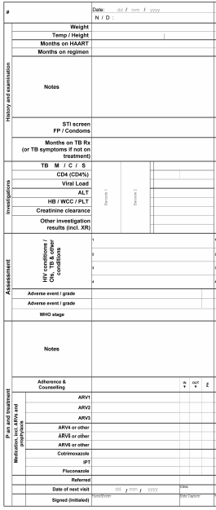
Visit Summary

Slide 17
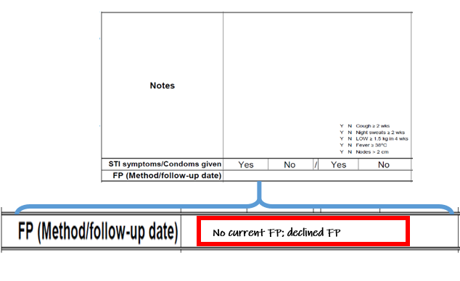
Family Planning and Contraception
Visit Summary
Notes:
Slide: Family Planning and Contraception
Say:
Under the ”Notes” section there is a place for documentation that family planning was discussed, offered and accepted or declined by the patient.

Slide 18
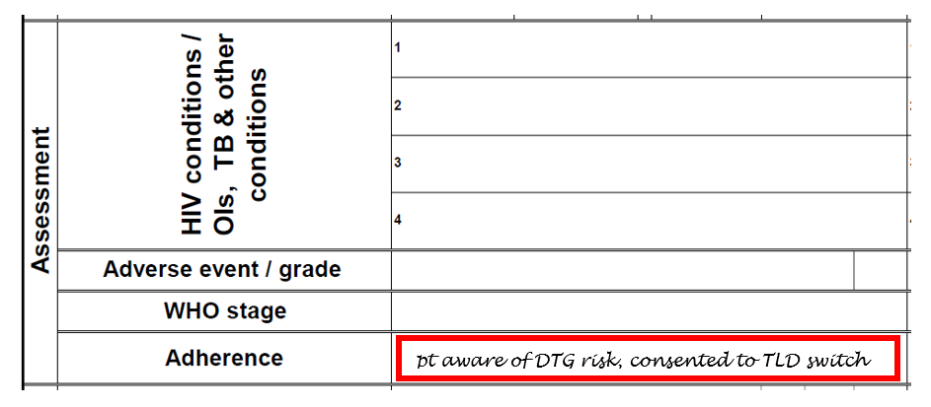
Consent to using TLD or DTG
Notes:
Slide: Consent to using TLD or DTG
Say:
Lastly, in the “Assessment” section, understanding of DTG risk and consent for use of TLD can be documented
It is critical to ensure that all women of childbearing age have this documentation, particularly if they are on TLD or another DTG-containing regimen

Slide 19



Summary of 1st Line Regimens
Integration of ART and Family Planning services essential!
Neonates, Infants & Children 0 to < 10 years of Age, Adolescents and Adults
2.5 kg
Birth to < 4 wks of age ³
3 kg
> 4 wks of age, and > 42 wks gestational age⁴
20 kg
Or < 10 years of age
35 kg
and > 10 years of age
Neonates AZT + 3TC + NVP
Infants & Children ABC + 3TC + LPV/r
Children ABC + 3TC + DTG
Adolescents & Adults
TDF + 3TC + DTG/EFV
Notes:
Neonates: AZT, 3TC, and NVP
Infants and children 3 - <20 kg: ABC, 3TC, LPV/r (note EFV no longer in paeds regimens. However, children already suppressed and doing well on an EFV based regimen should stay on it, as a switch to LPV/r may affect adherence due to new side-effects and twice daily dosing
Children 20-<35 kg ABC, 3TC, and DTG (they qualify for DTG, but not yet for TLD as they are not yet eligible for TDF)
Adolescents and adults > 35kg TDF, 3TC, and DTG (TLD). Precautions in women of child bearing potential (WOCP) to follow on next slide)
Remember that any switch/transition of only one drug in a regimen requires a suppressed VL

Slide 20



Dual Treatment of HIV and Active TB
Efavirenz
has no significant interaction with rifampicin
Dolutegravir
has significant interaction with rifampicin
Therefore, TB/HIV co-infection impacts on ART drug selection as follows:
Clients who are not yet on ART when TB treatment is initiated
TB Treatment started first
Initiate ART with an EFV-containing regimen
Once daily
Clients who are already on ART when TB treatment is initiated
Adults who are already on an EFV-containing regimen
→ continue the EFV-containing regimen
ART started first
Clients who are already on a DTG-containing regimen
→ remain on DTG and boost DTG dose to 50 mg bd
Twice daily
Notes:
Tb/HIV co-infection affects ART drug selection:
Adult clients who are not yet on ART when TB treatment is initiated should initiate ART with an EFV-containing regimen.
Adults who are already on an EFV-containing regimen when TB treatment is initiated should continue the EFV-containing regimen whilst also taking TB treatment. Continue until 2 weeks after TB treatment is completed.
Clients who are already on a DTG-containing regimen when TB treatment is initiated should remain on DTG and boost the DTG dose to 50mg bd until 2 weeks after TB treatment is completed.
Remember that TB/HIV co-infection also impacts on ART in a number of other ways. It also affects:
2. The timing of ART initiation in clients co-infected with TB
Defer ART initiation as follows:
If CD4 < 50 cells/μL –initiate ART within 2 weeks of starting TB treatment, when the patient’s symptoms are improving, and TB treatment is tolerated
If CD4 ≥ 50 cells/μL – initiate ART 8 weeks after starting TB treatment
3. Drug interactions have already been discussed. DTG boosting required with Rifampicin to 50mg bd
4. Adherence, due to increased pill burden
5. Side-effects due to overlapping toxicities, e.g. hepatic toxicity

Slide 21
Re-initiating ART in Treatment Interrupters
Take a thorough history including:
which drugs the client was taking, and for how long;
the reasons for stopping ART;
side-effects; and
any information on VL measurements whilst on ART.
If the patient was
clinically well on their first-line regimen,
side-effects were not the reason for stopping ART, and
their VL was suppressed (or no VL result is available)
Restart their original regimen
(TEE)
Do a VL after 3 months on ART
Do a VL after 6 months on ART
If VL > 1000, consider 2nd line in accordance with their current regimen
VL > 50
Majority should suppress by 3 months
If VL < 50, give option to switch to DTG
Continue routine VL monitoring
If VL < 50, give option to switch to DTG
Notes:
Take a thorough history including:
1) which drugs the client was taking, and for how long;
2) the reasons for stopping ART;
3) side-effects; and
4) any information on VL measurements whilst on ART.
• If the patient was well on their first-line regimen, side-effects were not the reason for stopping ART, and their VL was suppressed (or no VL result is available), restart the first-line regimen they were on at the time of interruption. Do a VL after 3 months on ART. The majority of clients should suppress by 3 months on ART. For those that remain unsuppressed provide enhanced adherence support and repeat the VL at 6 months on ART (3 months later). If their VL is still unsuppressed at 6 months on ART, manage the virological failure in accordance with their specific regimen.
If in doubt, contact one of the helplines provided on page 16 of the abridged GL.
• If the client stopped treatment due to side-effects, manage as outlined in the comprehensive Consolidated HIV Guidelines
document, or contact one of the helplines provided on page 16.
• If the client was failing but is still clinically well, consider restarting their original first line therapy.
• If the client is ill, consider a new regimen, consulting an experienced clinician as necessary.

Slide 22
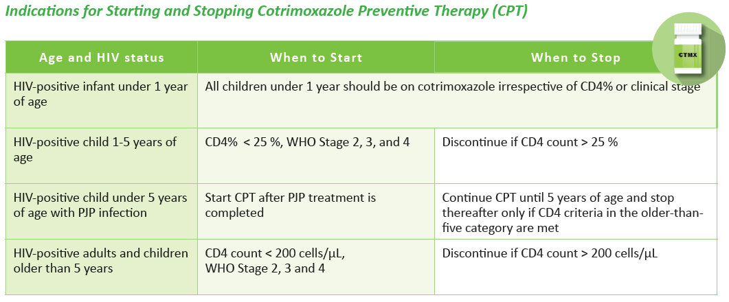
Cotrimoxazole Preventive Therapy
Only 1 CD4 count needed to stop CPT
Notes:
There has been some controversy over the CD4 count of 200 vs 350 for CPT eligibility.
After much discussion amongst experts and to align with the EML, SA will now be going with the CD count of 200 cut-off

Slide 23
Monitoring on ART and Switching Regimens

Slide 24
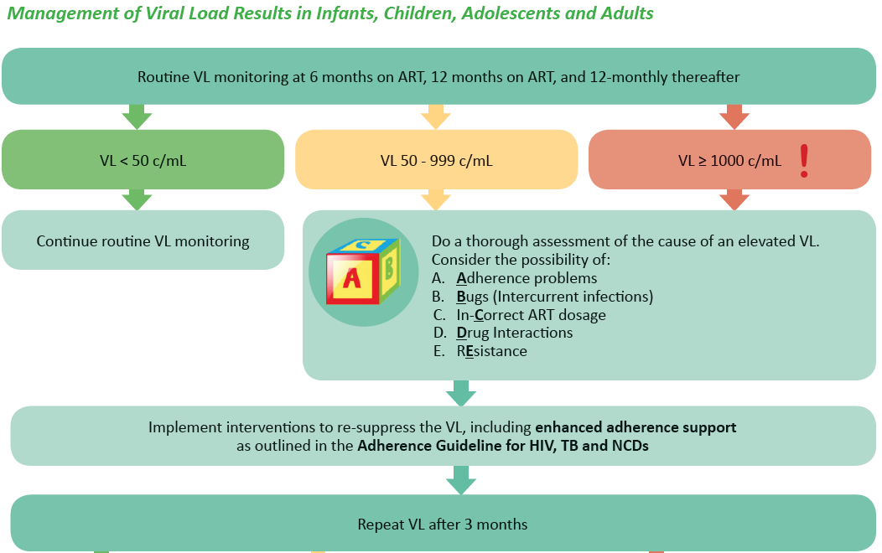
Part 1
Notes:
Part 1
Any VL > 50 c/mL is a medical emergency and requires action.
Do a thorough assessment using the ABCDE. Take into consideration all the factors discussed in the previous slides
Implement interventions accordingly
Repeat the VL in 3 months

Slide 25
VL Monitoring- Part 1 Take home message:
Any VL > 50 c/mL is a medical emergency and requires attention:
Thorough Assessment: ABCDE
Implement Interventions accordingly
Repeat VL after 3 months

Slide 26
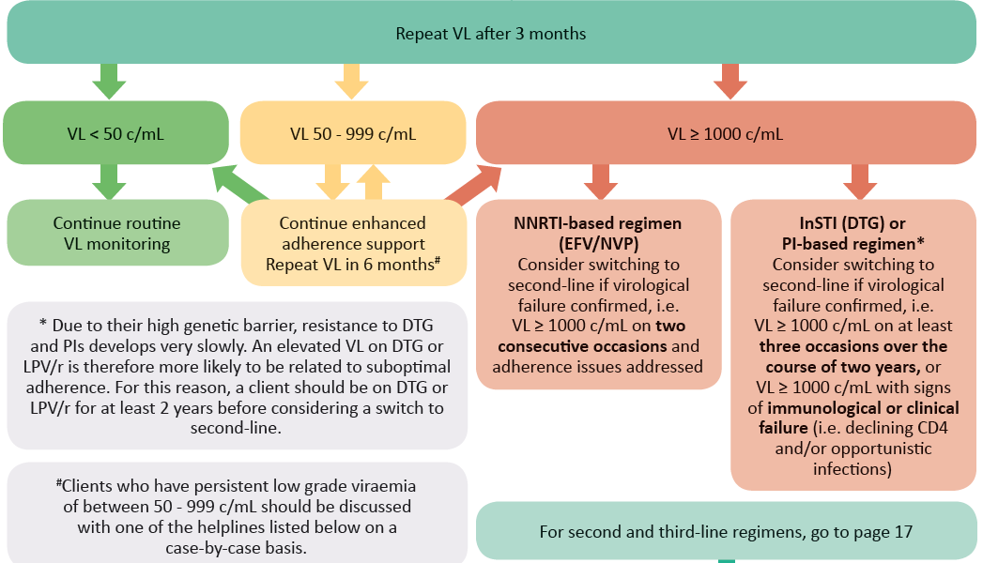
VL Monitoring – Interpreting the Results of the VL Repeated after 3 Months
Part 2
Switching for virological failure will now depend on
Current regimen (NNRTI vs InSTI/PI)
Duration on ART
Notes:
The results of the viral load repeated after 3 months:
Most clients will either
Revert back to VL < 50 c/mL, or
Progress to VL > 1000 c/mL (outright failure if on a NNRTI)
Small minority will remain between 50-1000, and if this persists, they should be discussed with an expert
The definition of “confirmed virological failure” remains the same for NNRTI-based regimens, i.e. 2 VLs > 1000 c/mL on at least 2 occasions. However, due to their high genetic barrier, resistance to DTG and PIs develops very slowly. An elevated VL on DTG or LPV/r is therefore more likely to be related to suboptimal adherence. For this reason, a client should be on DTG or LPV/r for at least 2 years before considering a switch to second-line. Confirmed virological failure for a client on a DTG or PI-based regimen will therefore be: VL > 1000 c/mL on at least three occasions over the course of two years, or VL > 1000 c/mL with signs of immunological or clinical failure (i.e. declining CD4 and/or opportunistic infections)
Clients who have persistent low grade viraemia of between 50 - 1000 c/mL should be discussed with one of the helplines listed below on a case-by-case basis.

Slide 27
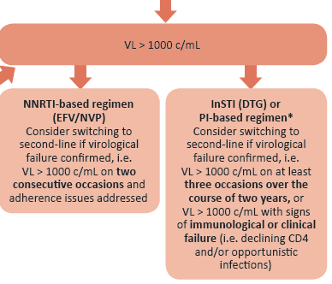
VL Monitoring- Part 2
Take home message
Most client will either
Revert back to VL < 50 c/mL, or
Progress to VL > 1000 c/mL (outright failure)
Small minority will remain between 50-1000, and if this persists, they should be discussed with an expert
Switching for virological failure will now depend on
Current regimen (NNRTI vs InSTI/PI)
Duration on ART
Notes:
Due to their high genetic barrier, resistance to DTG and PIs develops very slowly. An elevated VL on DTG or LPV/r is therefore more likely to be related to suboptimal adherence. For this reason, a client should be on DTG or LPV/r for at least 2 years before considering a switch to second-line.
Clients who have persistent low grade viraemia of between 50 - 1000 c/mL should be discussed with one of the helplines listed below on a case-by-case basis.

Slide 28
2nd Line Regimens in Adults
Progression will be:
DTG should always be used with at least one active NRTI (DAWNING study)
PIs remain active even with 2 inactive NRTIs (EARNEST study)
Resistance testing if failing PIs (InSTI only after discussion with an expert)
NNRTI-based regimen
EFV
InSTI-based regimen
DTG
PI-based regimen
LPV/r
ATZ/r
PI as alternative if DTG not suitable i.e. women wanting to conceive

Slide 29
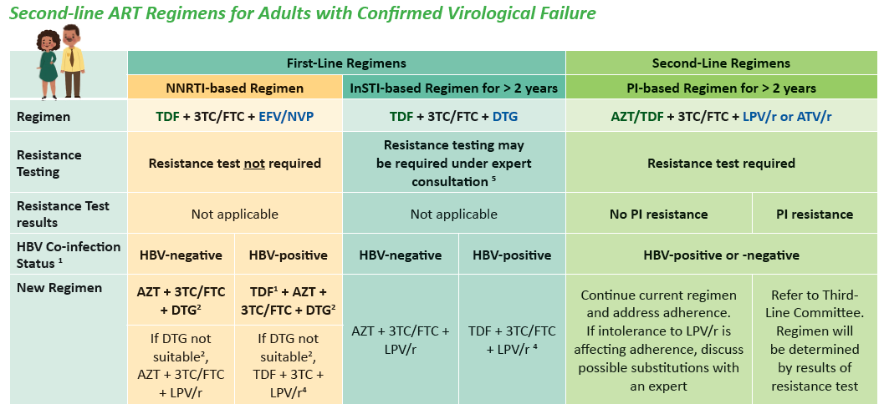
Notes:
Deciding on a second line regimen depends on:
1. The current regimen the client is failing
2. Whether resistance testing is indicated and results available or not
3. HBV co-infection status

Slide 30
2nd Line Regimens in Children
Progression will be:
PI-based regimen
LPV/r
ATZ/r
NNRTI-based regimen
EFV
< 20 kg
> 20 kg
Resistance test required
Must ensure that at least 1 NRTI is active
> 20 kg
InSTI-based regimen
DTG

Slide 31
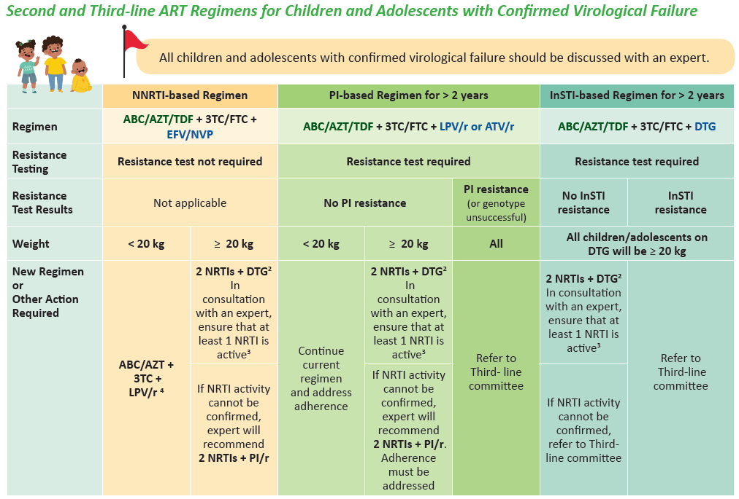

Slide 32
Switching between EFV and DTG
Overarching principle:
Never change only one drug in a failing regimen!
A single drug switch to DTG requires a VL of < 50 c/mL in last 6 months
Also remember to:
Counsel her on risks and benefits of DTG vs EFV, and the risk for NTDs in subsequent pregnancies
Provide counselling on contraception post-partum
Check for potential drug interactions
Warn the client about new side effects that may be experienced when switching to a new drug
Notes:
Some clients will already be on EFV-containing ART when DTG becomes available
A single drug switch to DTG requires:
A VL of < 50 c/mL in last 6 months
Counselling on risks and benefits of DTG vs EFV, and the risk for NTDs in subsequent pregnancies
Counselling on contraceptive options post-partum
A check for potential drug interactions
The client to be warned about new side effects that may be experienced when switching to a new drug
Pregnant women already on ART should continue their current ART regimen pending the result of their 1st VL (to be done at entry into antenatal care).
Only if her VL is <50 c/ml, and she is no longer in the 1st trimester, offer her the option of switching to DTG.
Breastfeeding women on ART may switch to DTG if she has confirmed virological suppression in the last 6 months.
Any pregnant or breastfeeding woman with a VL ≥ 50 c/ml should be managed as per the VL Non-suppression algorithm
Should a women desire to become pregnant and need to switch from DTG back to EFV, she also requires a VL < 50 c/mL

Slide 33
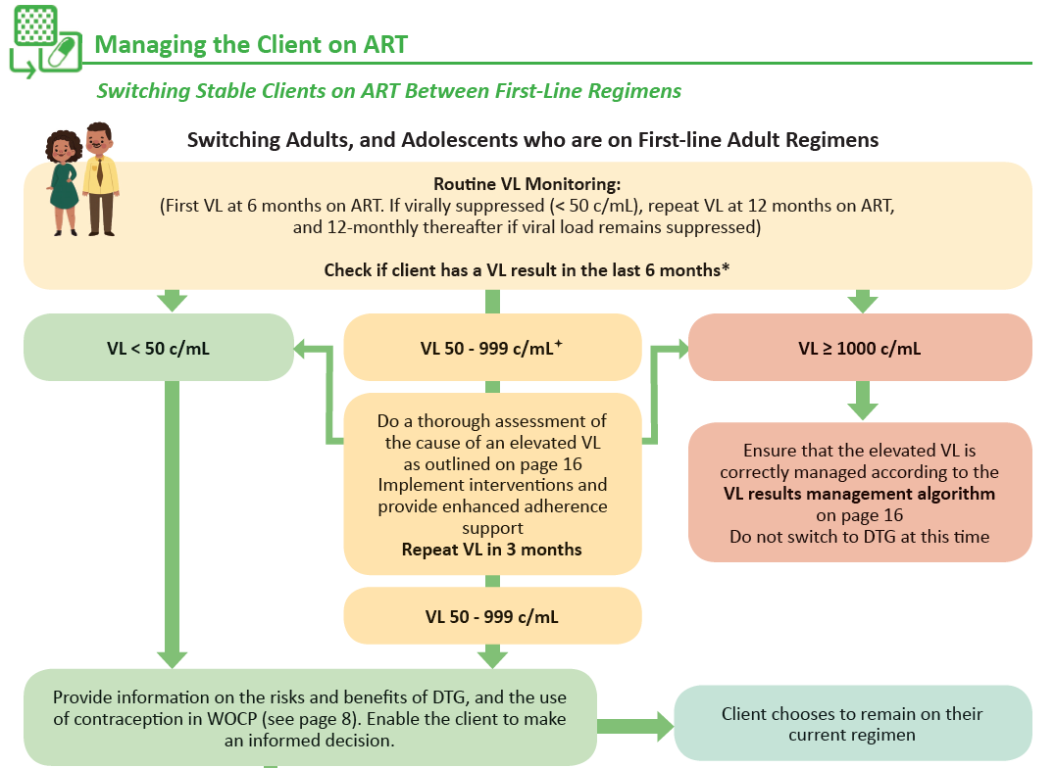
Switching from EFV to DTG
Never change only one drug in a failing regimen!
Once virological failure is confirmed with 2 VL > 1000, an entire regimen switch is required to DTG-based 2nd line with new NRTI backbone
Notes:
Initial VL < 50 it is safe to switch only one drug straight away (after appropriate counselling, etc.)
VL > 1000: they need to be worked up for possible virological failure that will require a full regimen switch.
For the category of 50-1000 we, in essence, want to make sure that we identify those who are actually on their way to failing with a VL > 1000. So at the repeat VL after 3 months:
If less than 50, that’s great, and we can switch
If again 50-1000, they may just be one of those with a low persistent viraemia, but we have confirmed that they are not progressing to outright failure with a VL > 1000. They can also switch
If > 1000, they have progressed to outright failure, and require a full switch to second line. This is the category we want to identify by repeating the VL. The aim is to protect dolutegravir. If a patient who is failing their current regimen is moved to dolutegravir and kept on the same NRTIs, to which there may already be resistance, there is a risk of developing dolutegravir resistance as a result.
A systematic review by Wandeler et al. showed that simplification to dolutegravir monotherapy in virologically suppressed patients results in virological failure in 6.4%, half of which develop resistance. This suggests that dolutegravir needs to be combined with effective NRTIs in a treatment regimen for long term virological suppression and to prevent development of dolutegravir resistance.

Slide 34
Important Principles for Transitioning
For efficiency reasons, transitioning to DTG should not put an additional burden on the health system by creating a need for additional visits or additional viral load tests. It is therefore important that the transition to TLD be integrated into existing processes and routine monitoring schedules, rather than creating new ones.
Therefore, if a client has not had a VL test in the last six months, additional VL testing outside of the routine VL monitoring schedule should NOT be done. The client should await the result of their routine annual VL test to determine their eligibility to switch to DTG.
The number of months for which a client receives ART and the timing of the routine VL testing should be aligned so as not to provide a client with a surplus of their original regimen when they may soon be switching to DTG.

Slide 35
Summary of Changes to the new PMTCT Guideline
Central Theme: Maternal Viral Load Suppression
Linking with HIV Prevention and Family Planning services
Integrating services for the mother-infant-pair
Promoting and protecting breastfeeding
Other cross cutting themes
Specific Changes
Antenatal care
Labour and delivery
Postpartum Care and Breastfeeding
HIV testing monthly at
every full BANC Plus visit
Delivery-VL
for all HIV+ women
HIV PCR at birth and 10 weeks remain
HIV-PCR at 6 months for all exposed
Maternal VL at 6 months and 6-monthly
18 month rapid/ELISA for all children
HIV confirmation with PCR until 24m
Stat NVP and TLD for women presenting in labour not on ART
Dolutegravir
Potent VL suppressor
Risk for NTDs
Drug interactions
High risk infant prophylaxis (also BF):
AZT for 6w
NVP for a minimum of 12w, until maternal VL suppressed
Provide mother with
2 months ART supply
at discharge
Breastfeeding for 24 months or longer in the context of viral suppression and enhanced infant prophylaxis

Slide 36
Summary
DTG is a significant game changer in SA’s ART arsenal
High genetic barrier to resistance and well tolerated
BUT significant drug interactions rifampicin (and others)
Possible risk of NTDs
Implications for women of childbearing potential
Need for integration of ART and family planning services
Viral suppression is now defined as a VL < 50 c/mL
Any VL > 50 means viral replication with risk of resistance → action is required!
Assess (ABCDE), intervention, repeat VL
Never switch only one drug in a failing regimen
If there VL in last 6 months, they may switch to DTG after appropriate counselling etc.
If the VL is between 50-1000, do not switch immediately. Progression to outright failure must be excluded, by ensuring that the repeat VL remains below 1000
Virological failure requires a complete regimen switch, (including the NRTI backbone)
Resistance testing indicated if failing a PI for > 2 years

Slide 37
Thank you

